Slide 1


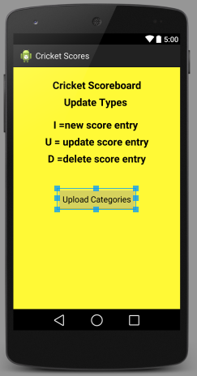

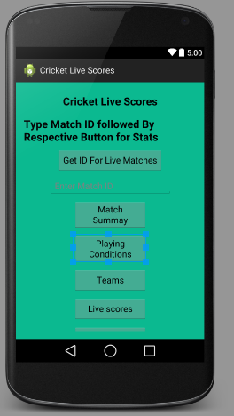

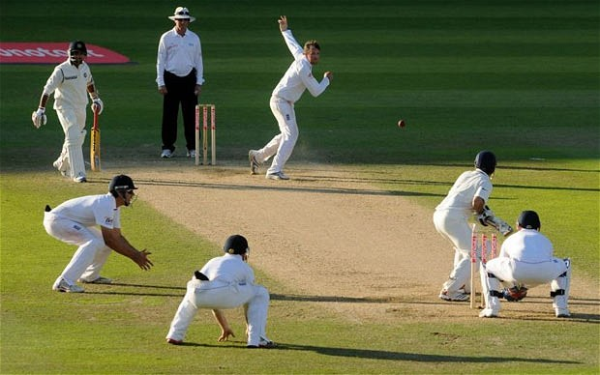
Cricket Score
Keeping
App
User App
Cricket Match
Admin App

Slide 2


Cricket Score
Keeping App
Database
Server
User App
Admin
Score
Keeper
Mobile App

Slide 3
Description of project
Database – MySQL Database.
Webserver-Apache Server.
Server side Scripting Language- PHP.
Project Consists of Two Android Applications.
One App is called Admin Score Keeping App.
Other App is called User App.

Slide 4
Description of project
In first part a connection is established to a database on server using PHP scripts.
After establishing the connection with database write further PHP Scripts for inserting information in database and retrieving information from database. (SQL query statements are used for inserting and retrieving of data from database in PHP Scripts.)

Slide 5
Description of project
In 2nd Part Android Applications are created Admin Score Keeping App and User App for live scores.
PHP scripts are modified to store the information from Android Applications in variables which can be send to the server and fetch information from database and display in Application via toast.

Slide 6
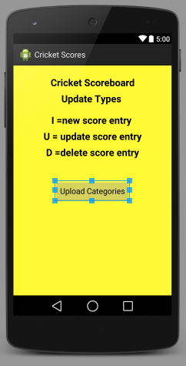
Admin Score Keeper App Main Activity
Main Activity Defines about Update Types and Starts new Activity for different categories of uploads with the Button press.

Slide 7
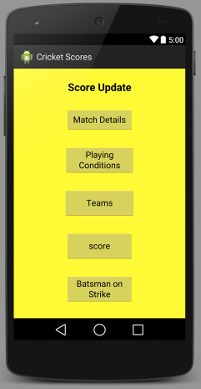
Register Activity
Register Activity have 5 Options
Each Buttons Starts New Activity

Slide 8
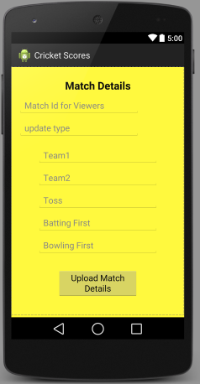
Match Details
This Activity has
7 Text Fields
1st Text Field for Id number for viewers
2nd is for update Type
3rd and 4th for Team Names
5th for the Team who won the Toss
6th for Batting Team
7th for Bowling Team

Slide 9
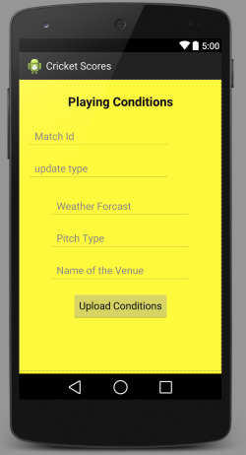
Playing Conditions
This Activity has Text
Fields for Match ID, Update Type , Weather
Forecast , Pitch Type
And for the Name of the Venue

Slide 10
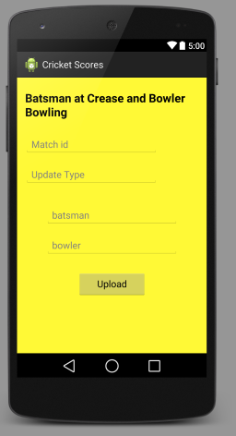
Current Batsman And Bowler
This Activity has
Text Fields for Match ID, update Type, Batsman Batting and Bowler Bowling.

Slide 11
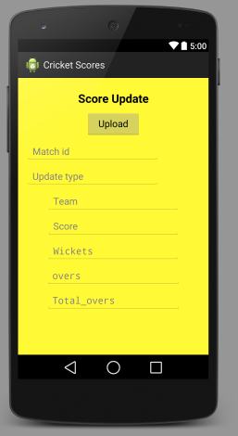
Score Update
This Activity has
Text Fields for Match Id , update Type , Team Name, Score , Wickets , Overs , Total Overs

Slide 12
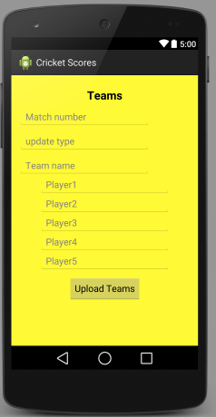
Teams
This Activity has
Text fields for Team Name and Players Playing from that Team.

Slide 13
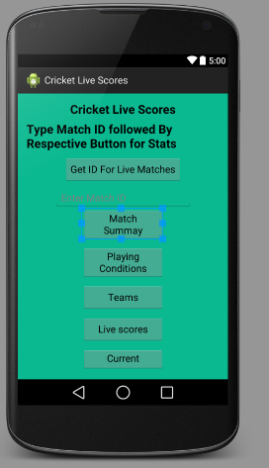
User App
In User App Main Activity has 6
Buttons and a text field.
Get ID is used to get Ids for all on going matches.
Text Field is used to type Match ID followed by Respective Buttons for Particular Stats.

Slide 14


